Slide 1

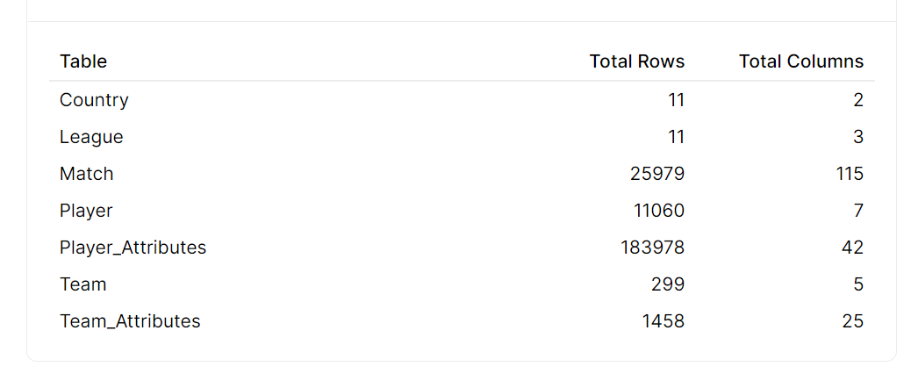
DATA DESCRIPTION This database is downloaded from kaggle uploaded by HUGO MATHIEN by name European Soccer Database. This dataset contain matches from 2009-2016.
Final Project EDA OF EUROPEAN SOCCER
BY-
NAVEEN REDDY GARLAPATI
NITHIN KUMAR ALLAM
AMULYA POTLURI
KUDIKALA SRI VAISHNAVI
BHANU SRI SOMANI

Slide 2

OBJECTIVE
Objective
European soccer league is one of the most viewed sports, thus data analysis of the game would provide insights on how we can increase ad revenue .
The objective is to target successful teams, by analyzing the result of each game and derive more outcomes by visualizing the team data.

Slide 3



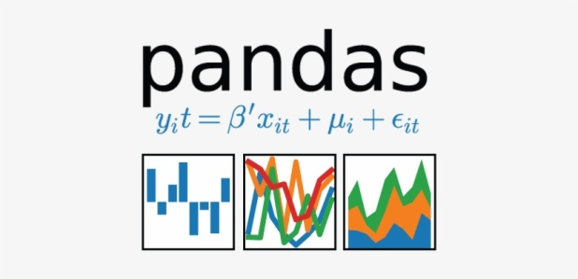


DATA DESCRIPTION This database is downloaded from kaggle uploaded by HUGO MATHIEN by name European Soccer Database. This dataset contain matches from 2009-2016.
SOURCES AND VISUALIZATION TOOLS

Slide 4
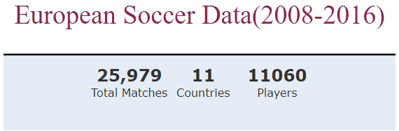
DATA DESCRIPTION This dataset contains European soccer matches from 2008-2016.
On analyzing the above data:

Slide 5
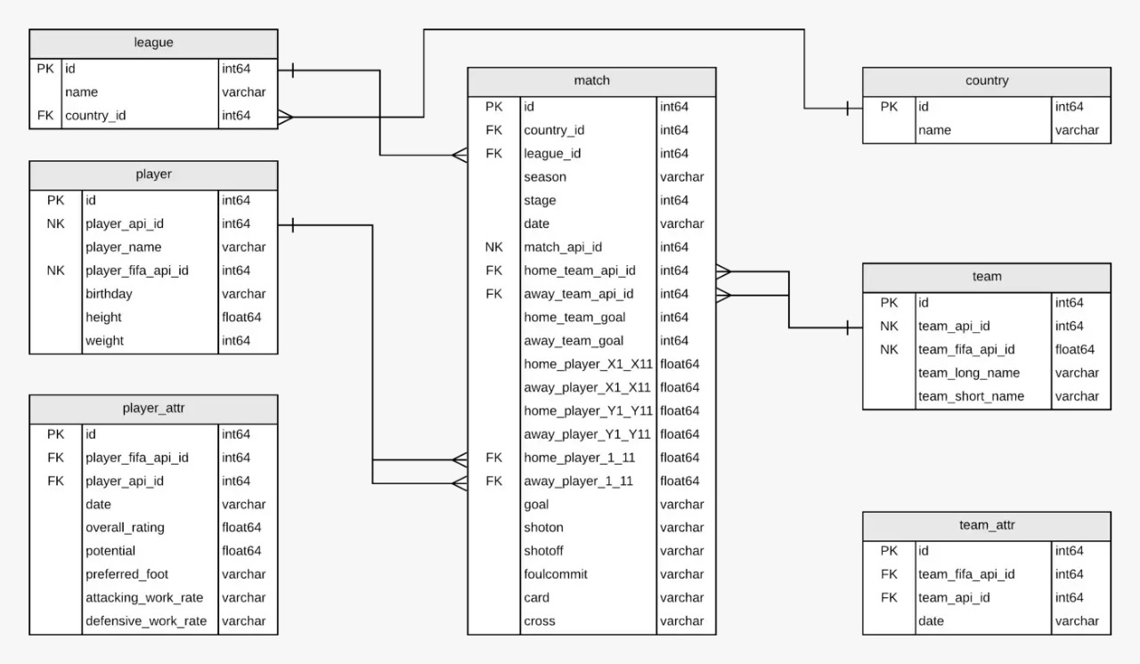
ER DIAGRAM

Slide 6
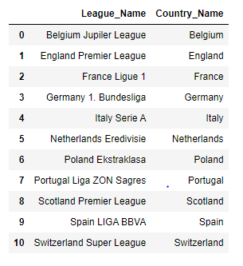
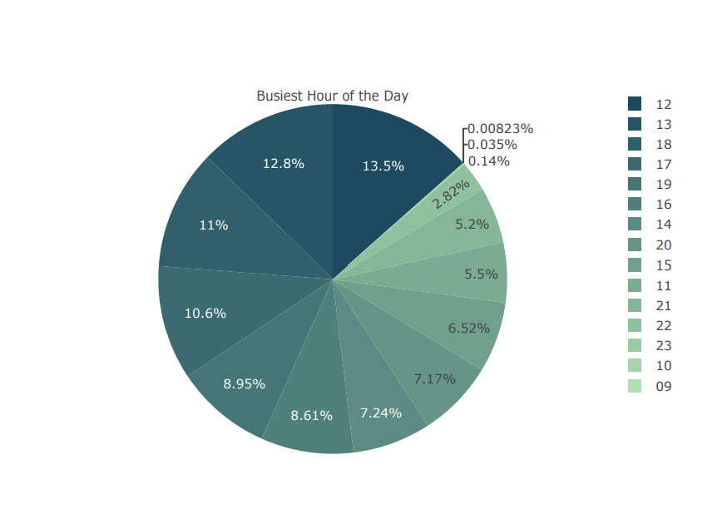
League names and corresponding countries
12th hour of the day, is the period with highest sales. Although busiest times of the day are afternoons and evenings

Slide 7
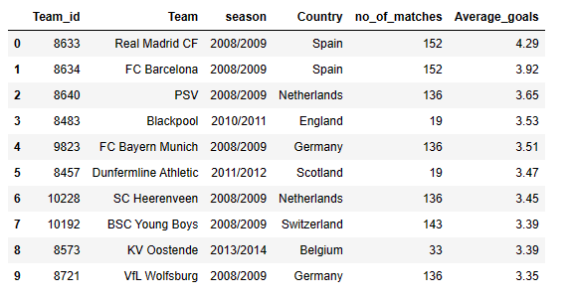
TOP 10 TEAMS

Slide 8


DATA DESCRIPTION This database is downloaded from kaggle uploaded by HUGO MATHIEN by name European Soccer Database. This dataset contain matches from 2009-2016.
Using SQL Queries

Slide 9
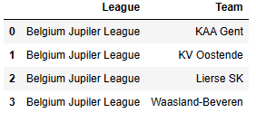
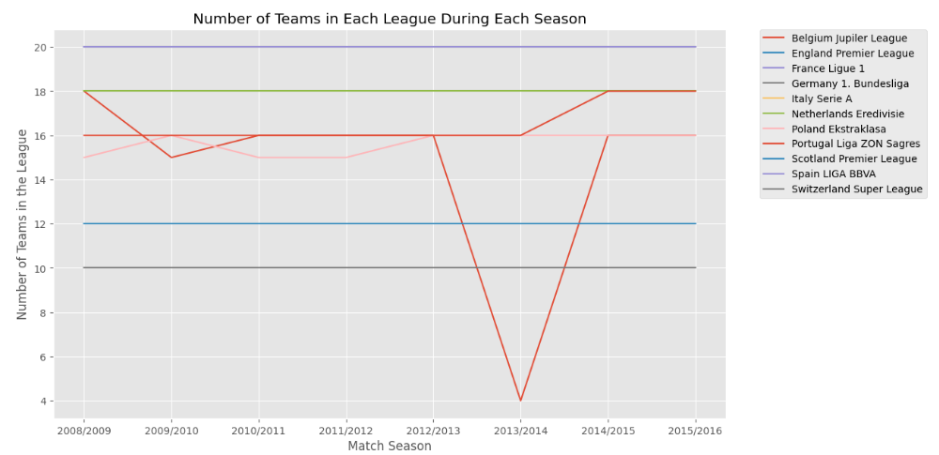
Season wise League Analysis

Slide 10
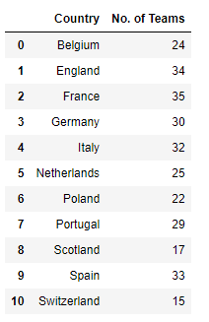
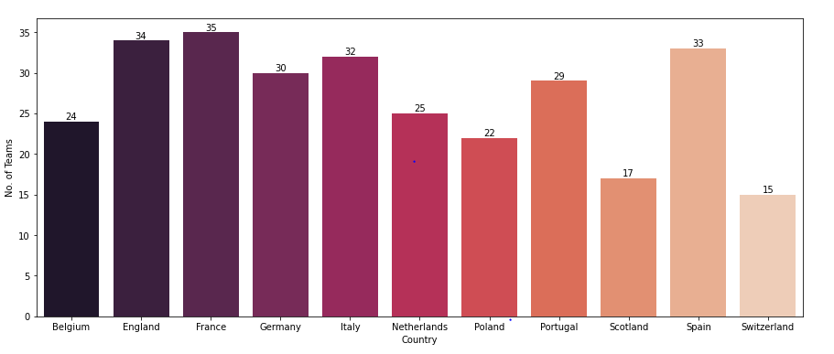
No. of teams in each country

Slide 11
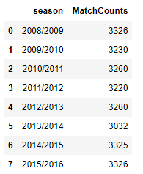
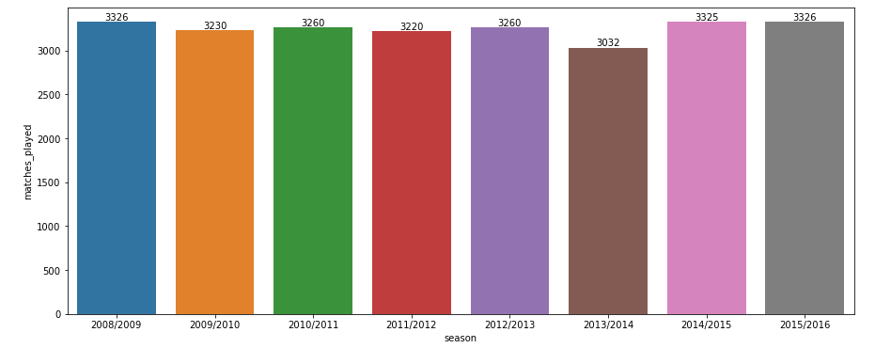
Total number of matches played per season

Slide 12
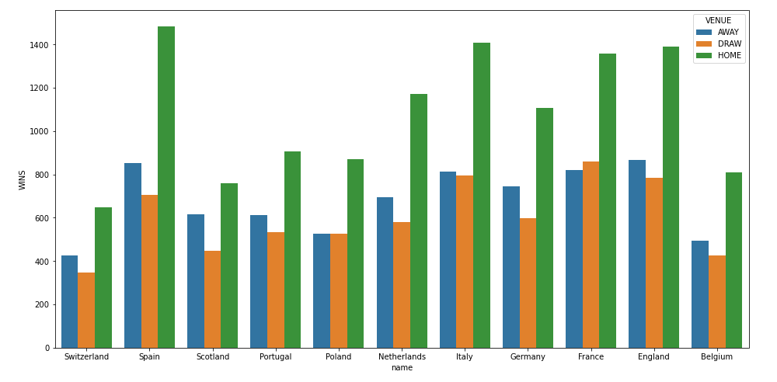
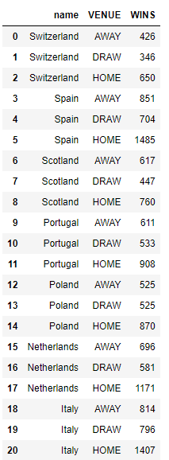
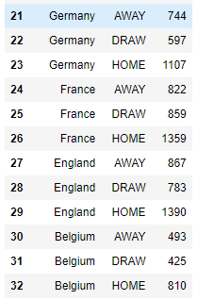
Home sweet home !!

Slide 13
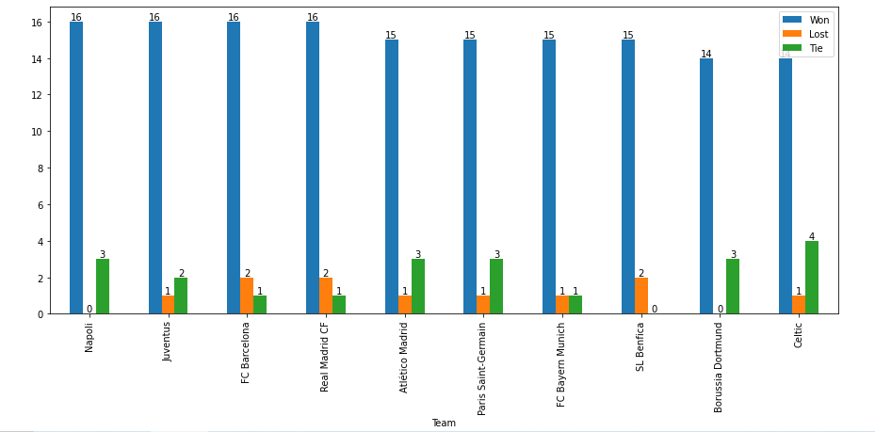
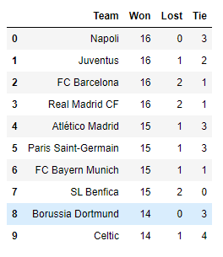
Most successful teams of 2015/2016 season

Slide 14
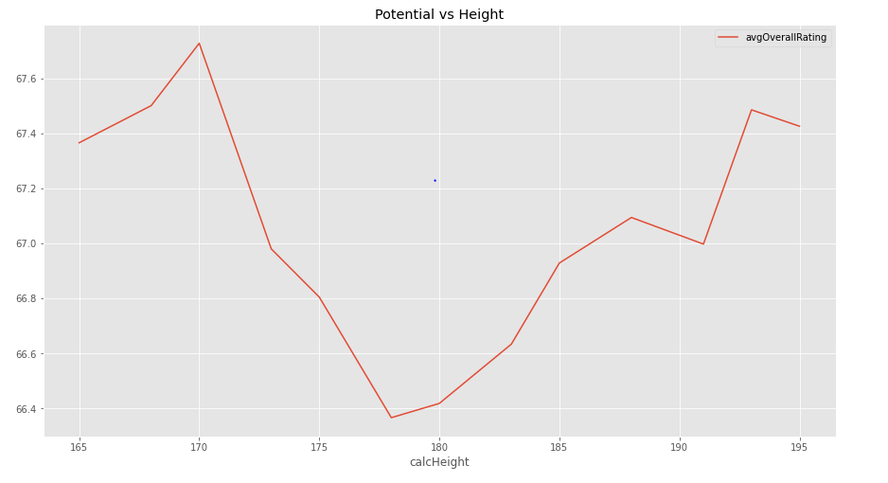
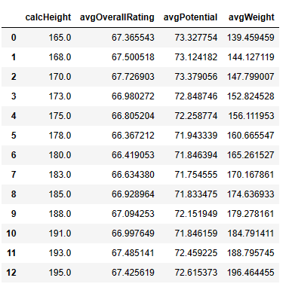
Player Height VS Potential

Slide 15
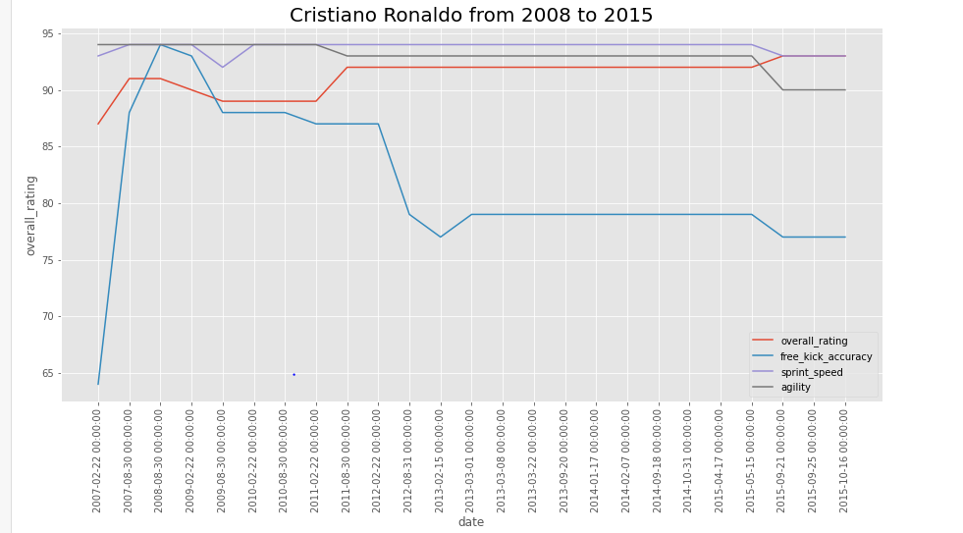
Target player analysis(Cristiano Ronaldo)

Slide 16
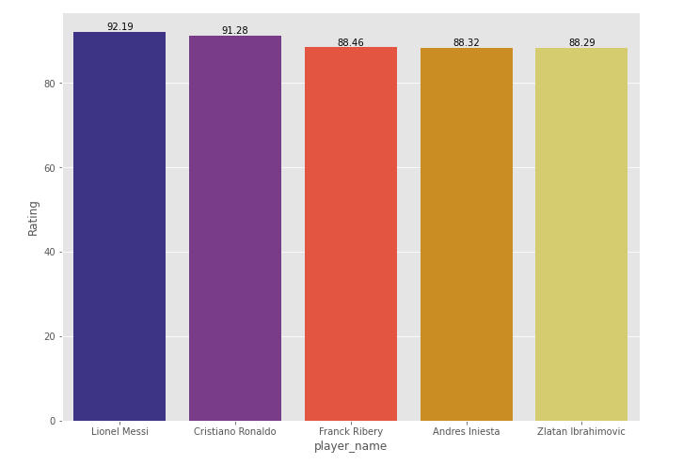
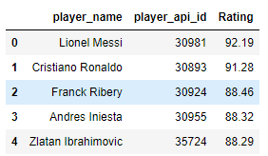
Top performing players
Targeting the top performing players can increase the probability of generating more ad revenue as they have a larger fan base.

Slide 17
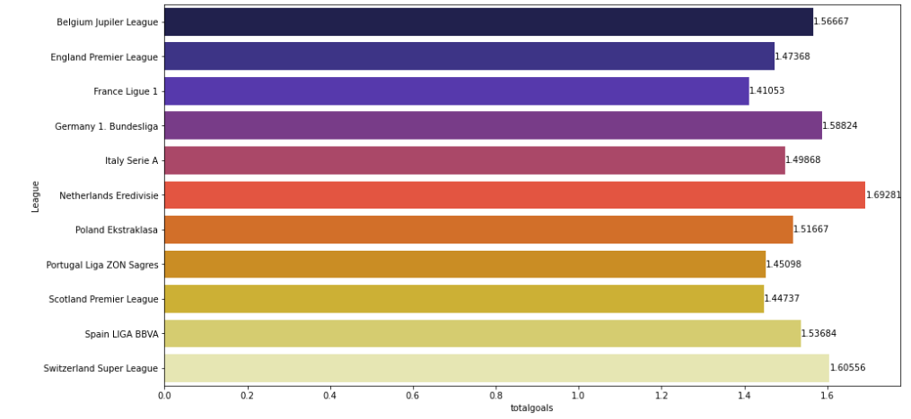
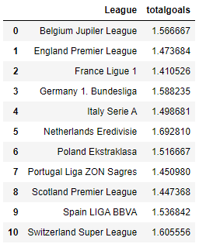
Total no. of Goals scored by each League

Slide 18
Expenses
Hardware and Brand endorsement | Price
Workstation and hardware equipment | $5000
Soccer player promotion fees | $50000
Software | Price
Google Colab | NA
Google cloud storage (2TB) | $100/year
Staff resources | Price
Data Engineer | $50 per hour
Business Analyst | $60 per hour
Software engineer | $50 per hour

Slide 19
Conclusion
Targeting players with huge fan base for advertisement helps better brand endorsement.
Advertisement in home games generates more revenue and reaches greater target audience.
One interesting insight is that the number of teams in all leagues are constant during different seasons except for "Belgium Jupiler League" which seems to have fluctuating teams during different seasons.
In 2013/2014 season there were only four teams, KAA Gent, KV Oostende, Lierse SK, Waasland-Beveren in Belgium Jupiler League.
Poland Ekstraklasa and Portugal Liga ZON Sagres also have some fluctuations.

Slide 20
REFERENCES
https://www.kaggle.com/datasets/abdelrhmanragab/european-soccer-database
https://www.researchgate.net/publication/343947808_Data_Analyses_of_European_Soccer
https://www.seanyeon.com/post/soccer-data-analysis
https://github.com/KorbHub/Soccer_SQL
https://am2958.medium.com/soccer-data-analysis-e911eccc8369
http://football-data.mx-api.enetscores.com/ : scores, lineup, team formation and events
http://www.football-data.co.uk/ : betting odds.
http://sofifa.com/ : players and teams attributes from EA Sports FIFA games. FIFA series and all FIFA assets property of EA Sports.

Slide 21
THANK YOU

